Slide 1
h | a
2 | 8
3 | 12
4 | 16
5 | 20
The table below shows the proportional relationship between the time in hours (h) Adrian babysits and the amount in dollars (a) Adrian earns babysitting.
The equation a = 5h shows the relationship between the amount in dollars (a) Iris earns babysitting and the time in hours (h) Iris babysits.

Slide 2
Which statement correctly identifies who earns more and how much more he/she earns?
A) Adrian earns $1 more per hour than Iris.
B) Adrian earns $4 more per hour than Iris.
C) Iris earns $1 more per hour than Adrian.
D) Iris earns $5 more per hour than Adrian.

Slide 3
Select all ordered pairs that satisfy the function y = –2x + 3?
A) (1, 5)
B) (2, -1)
C) (–3, 9)
D) (6, -9)

Slide 4
Gasoline costs $1.85 per gallon at a gas station.
Graph the proportional relationship between the number of gallons of gasoline and the total cost.

Slide 5
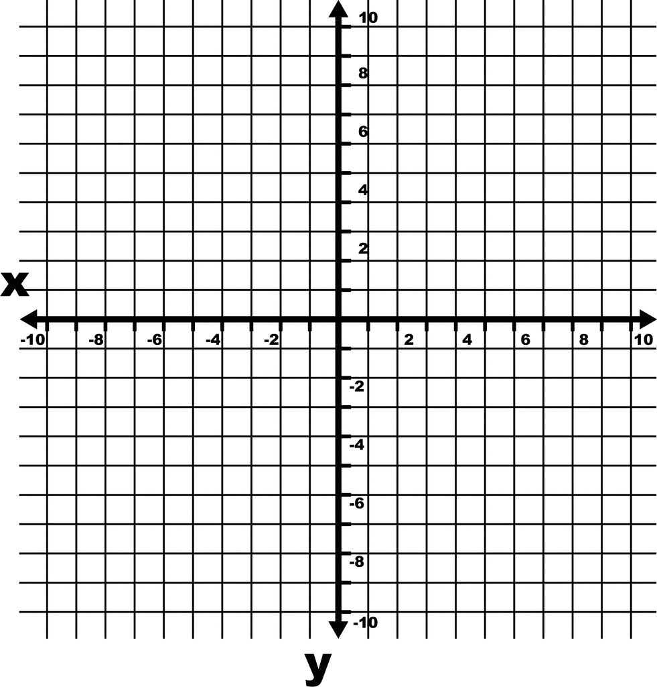

Slide 6
Since 12:00 a.m., a cold front has caused the temperature in a particular city to decrease at a constant rate. At 2:00 a.m., the temperature was 54 degrees Fahrenheit, and at 5:00 a.m., the temperature was 45 degrees Fahrenheit. Which of the following statements are correct? Select two that apply.

Slide 7
A) The temperature at 12:00 a.m. was 57 degrees Fahrenheit.
B) The temperature at 12:00 a.m. was 60 degrees Fahrenheit.
C) The temperature at 12:00 a.m. was 63 degrees Fahrenheit.
D) The temperature is decreasing at a rate of 3 degrees Fahrenheit per hour.
E) The temperature is decreasing at a rate of 9 degrees Fahrenheit per hour.
F) The temperature is decreasing at a rate of 11 degrees Fahrenheit per hour.

Slide 8
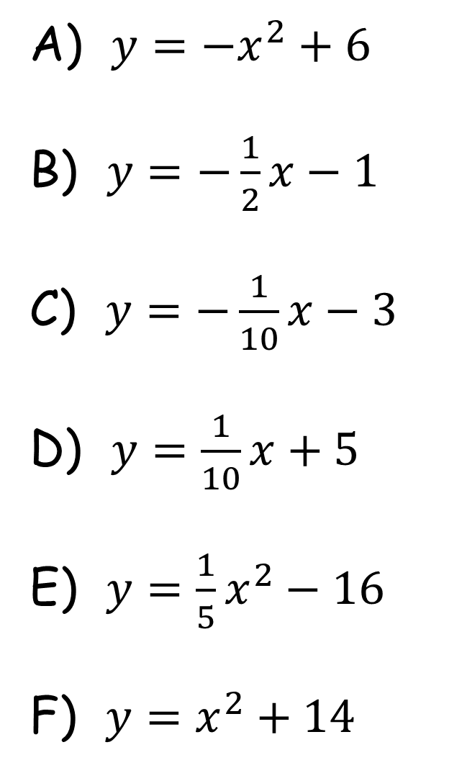
A) $y=−x^{2}+6$
B) $y=−\frac{1}{2}x−1$
C) $y=−\frac{1}{10}x−3$
D) $y=\frac{1}{10}x+5$
E) $y=\frac{1}{5}x^{2}−16$
F) $y=x^{2}+14$
The point (–10, 4) is on the graph of which of these functions? Select three that apply.

