Slide 1
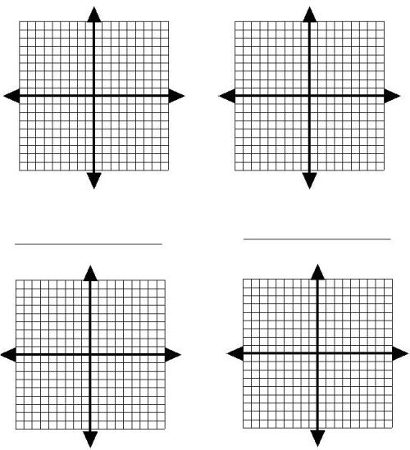

Graphing Linear Equations:$y=mx+b$
$$y= \frac{2}{3}x+3$$
$$y=−\frac{2}{3}x+4$$
$$y= \frac{3}{4}x −1$$
$$y=−4x −1$$

Slide 2
$$y= \frac{1}{4}x −6$$
$$y=−3x −3$$
$$y=3x −2$$
$$y=−5x+1$$

Slide 3


$$y= \frac{2}{5}x+2$$
$$y=−x+4$$
$$y=2x+3$$
$$y= \frac{1}{3}x$$

